Slide 1
American Express - Default Prediction
Title: Predicting Credit Card Default: A Machine Learning Approach
Author: Kausik Chattapadhyay
Institution: Bellevue University
Course: DSC680: Applied Data Science
Date: 05/25/2024

Slide 2

Abstract
Objective: Develop and apply a machine learning model for predicting credit card defaults using American Express data
Goal: Enhance accuracy of default predictions to improve risk management and lending decisions

Slide 3
Introduction
Problem: Credit card defaults pose significant risks to financial institutions
Solution: Accurate prediction can optimize lending strategies, mitigate risks, and improve customer experience
Focus: Build a predictive model using anonymized customer data from American Express

Slide 4
Business Problem
Aim: Leverage machine learning to assess the probability of customer default on credit card balance
Benefits: Optimize lending decisions, enhance risk management strategies, and improve customer experience
Context: Credit cards offer convenience but predicting repayment is challenging

Slide 5

Data Explanation
Objective: Predict the probability of future credit card payment defaults
Data: Anonymized and normalized customer profile features, categorized into delinquency, spend, payment, balance, and risk variables
Target Variable: Binary indicator of default within 120 days after the latest statement date

Slide 6
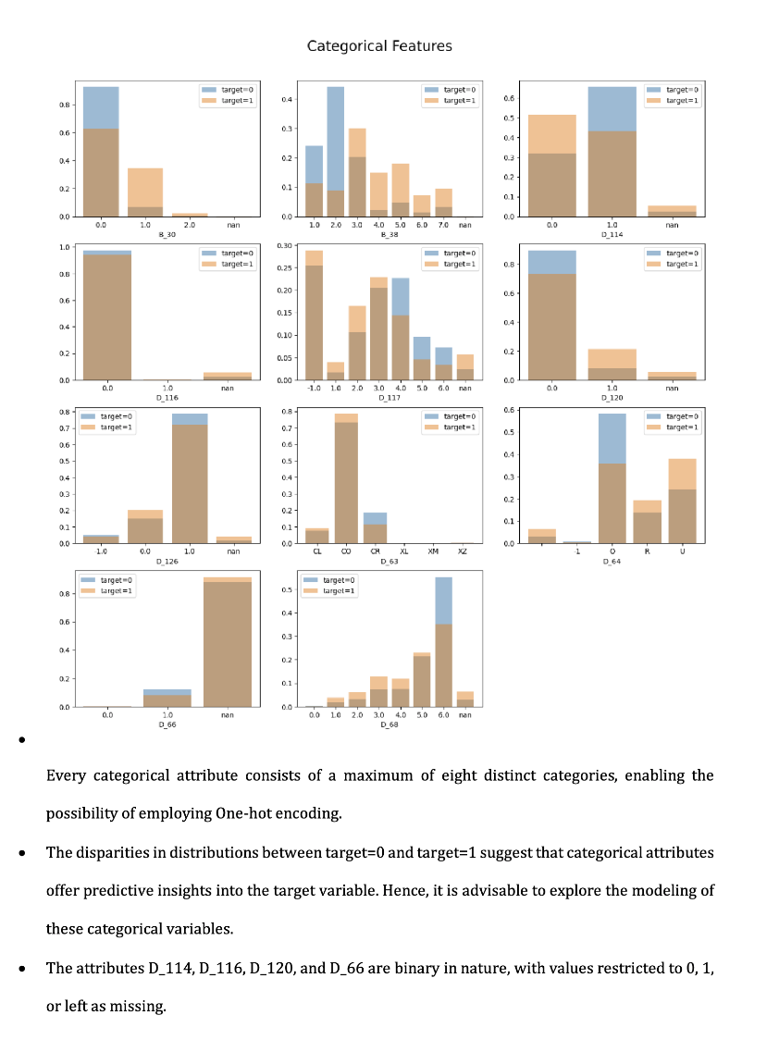
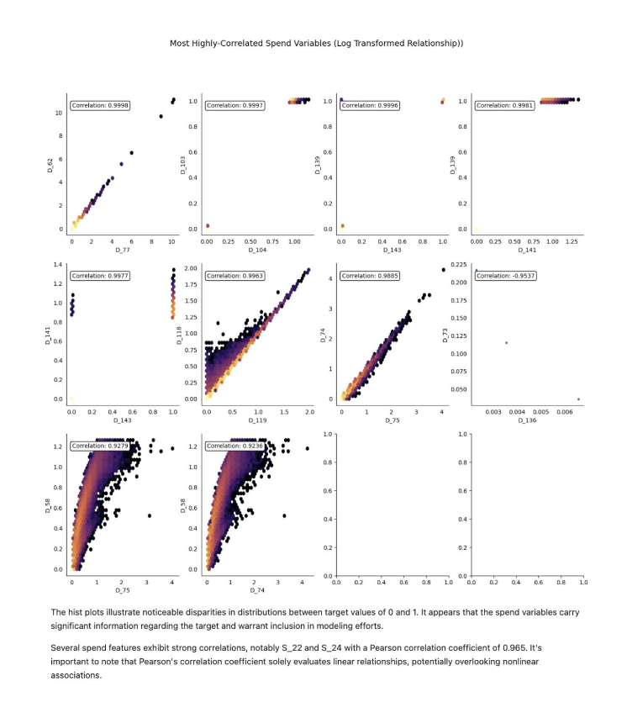

Slide 7
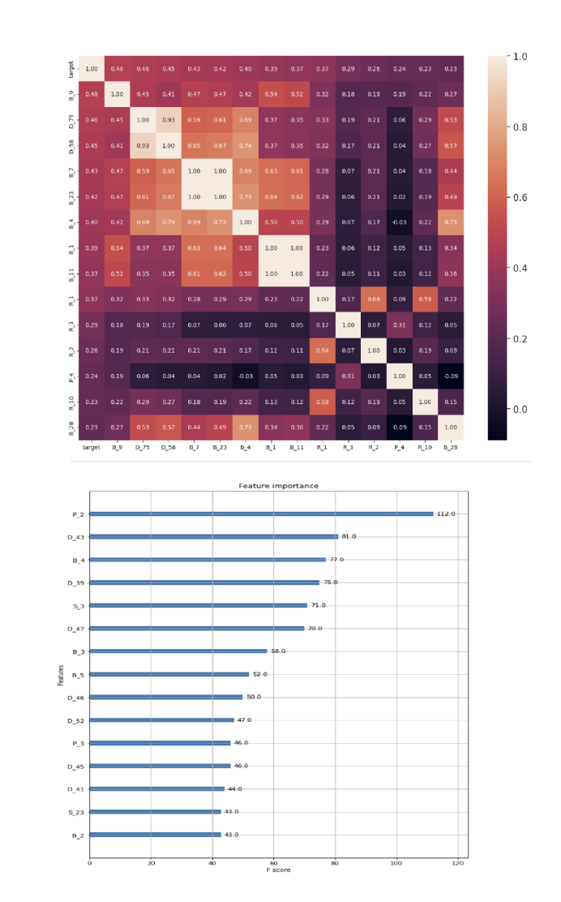
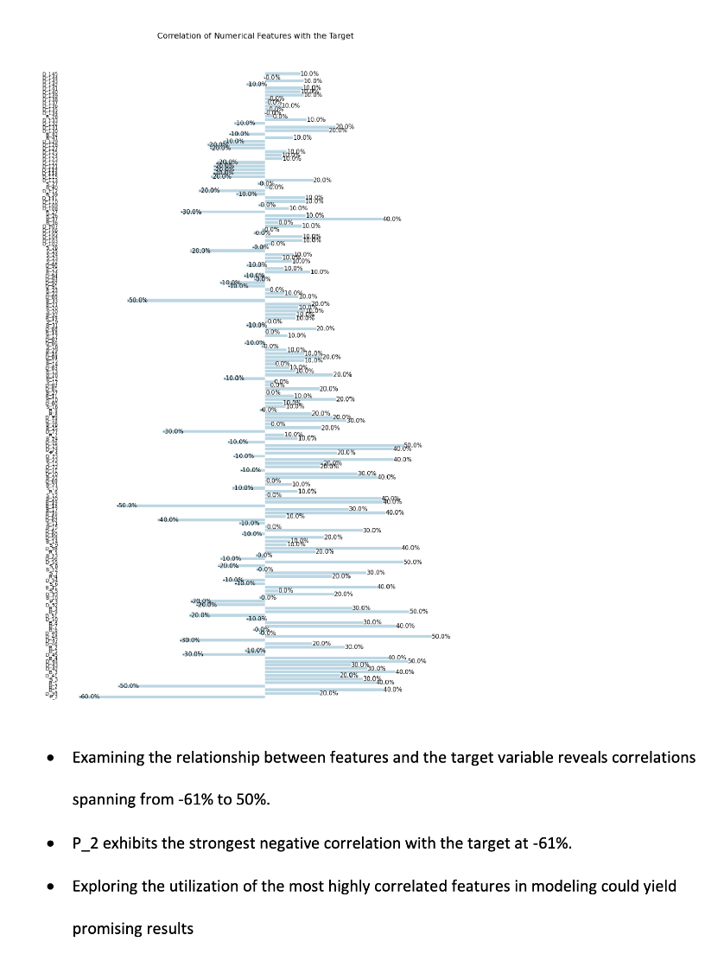

Slide 8

Data Preprocessing
Steps
Handle missing values by imputation or removal
Feature engineering through one-hot encoding, normalization, and scaling
Categories: Delinquency , Spend , Payment , Balance , Risk

Slide 9
Methods
Exploratory Data Analysis
Understand data distributions and relationships
Use visualizations like correlation matrices and scatter plots
Model Selection: Considered Logistic Regression, Decision Tree Classifier, and XGBoost Classifier
Model Training and Evaluation: Used cross-validation and evaluated with metrics like accuracy, precision, recall, and AUPRC

Slide 10
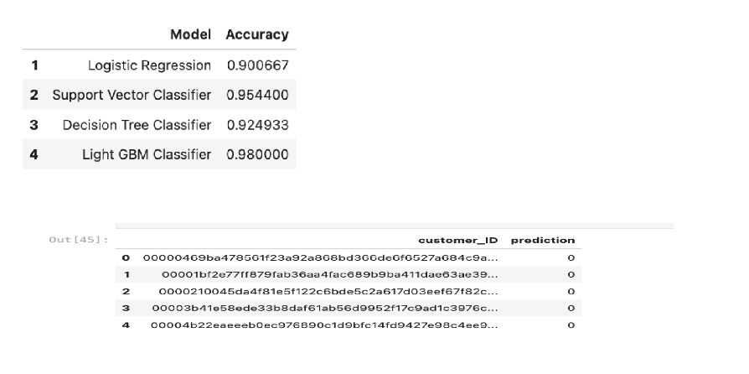
Analysis
Best Model: XGBoost Classifier with approximately 85% accuracy
Insights: Identified key features influencing predictions
Visualization: Performance visualized through confusion matrices and classification reports

Slide 11

Conclusion and Recommendations
Conclusion: The model provides a robust tool for assessing credit card default risk with high accuracy
Recommendations
Continuously update the model with new data
Implement regular audits to ensure fairness
Integrate the model into a broader risk management framework

Slide 12

Future Uses and Ethical Considerations
Future Uses
Integrate into real-time credit scoring systems
Extend to other financial products
Explore deep learning models for improved performance
Ethical Considerations
Ensure data privacy and confidentiality
Address potential biases
Adhere to regulatory guidelines like the Fair Credit Reporting Act

Slide 13
Key Benefits of Predictive Model for American Express
Enhanced Decision-Making: Accurate default risk assessments optimize credit approvals and risk management.
Improved Customer Experience: Personalized interventions and timely credit assessments boost satisfaction.
Cost Savings: Reduces credit defaults and operational costs in risk assessment.
Revenue Generation: Maintains a healthier loan book and offers competitive credit products to drive customer acquisition.
Scalability: Scales across the customer base, addressing data integrity and computational challenges.

Slide 14
References
Kaggle American Express Default Prediction Competition
Academic papers on credit risk modeling
Regulatory guidelines from FCRA and CFPB
Ethical frameworks for AI and machine learning
https://www.kaggle.com/competitions/amex-default-prediction/data

